Slide 1
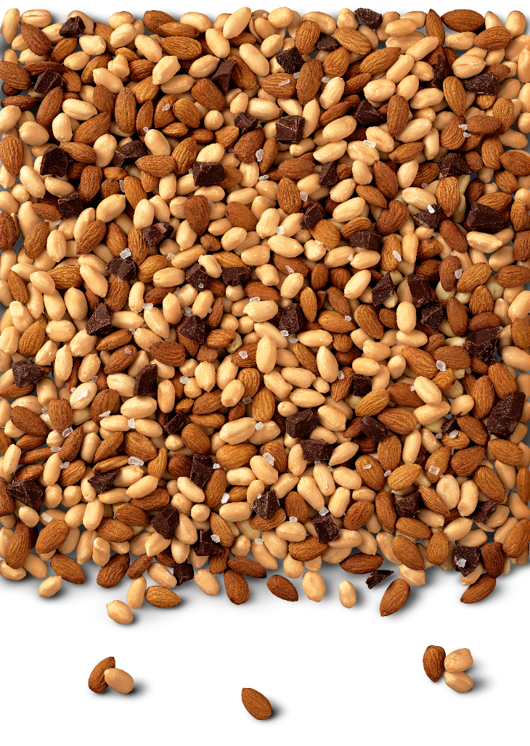

Activation Effectiveness Analysis
1st Interim Results
April 2, 2020

Slide 2
Objectives
Identify key activation levers that drive volume growth & optimize our marketing investment
Which marketing activation and investment mix delivers the highest RSV growth?
How should an investment priority ranking across all levers for markets look like?
Should we stay with current A&P reco 70% Field Marketing : 30% Digital Media or adjust?
NB:
20 - 30 wks activation data avaialbility (70% accuracy level)
Simplified approach focusing on output volume uplift per lever

Slide 3


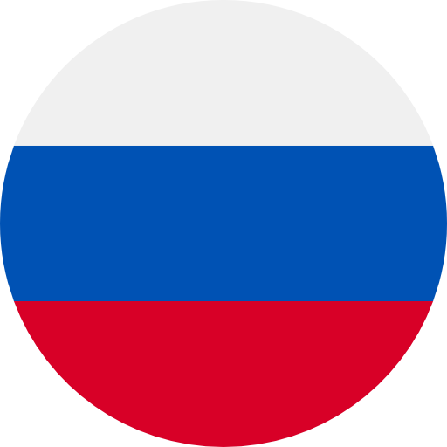



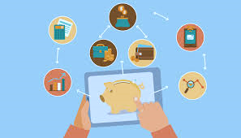
Phase 1
Phase 2
Phase 3
3 step approach
25th Feb – 31st Mar (5 Weeks)
1st Apr – 15th Apr (3 Weeks)
Pre-Modeling and Modeling
Identifying data, Feature engineering and Driver analysis
Market Deep dives
&
Budget Optimization Tools
France
Italy
Russia
UAE
Germany
Ireland
Weeks of observation
(56 Weeks)
(38 Weeks)
(31 Weeks)
(22 Weeks)
(20 Weeks)
(31 Weeks)
TODAY

Slide 4



Methodology
Data Harmonization
Feature Engineering
Key Lever Analysis
Budget Allocation Optimization
Syndicate data from different sources at the required level (post/event/ demo/sales at week levels)
Paid Media (IG, FB & Videos)
Owned Media (IG, FB, VK)
Events sampling
Instore demo data
RSV Data
Identify the right set of metric to use in the supervised model based on different analysis like quality, univariate, bivariate, correlation, etc.
Use supervised machine learning models (LASSO Regression) to identify key levers and their impact
Identify, isolate, & quantify impact of key levers
Use simplex method,
a linear programming algorithm to optimize and allocate spending thereby maximizing sales

Slide 5
First level market insights
France
Italy
Russia

Slide 6
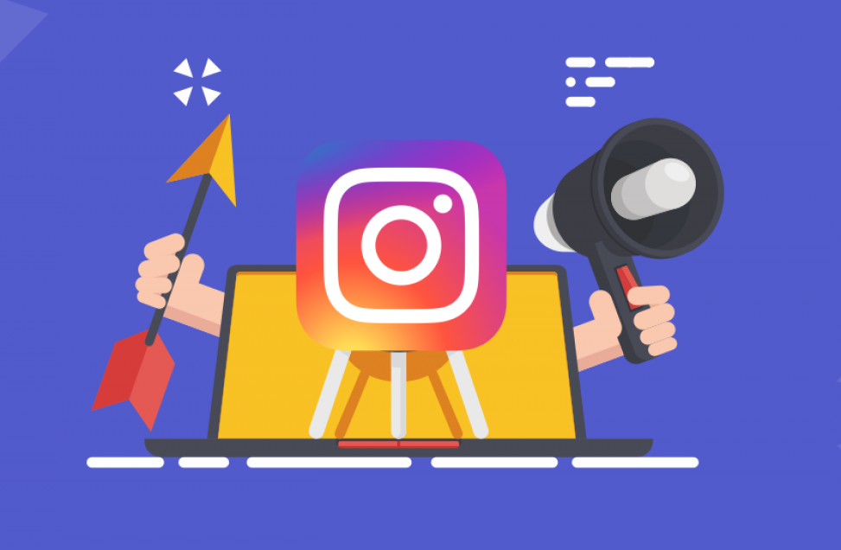

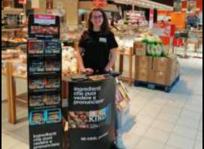
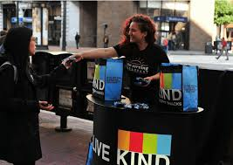
For same investment, Paid Media – Instagram will cause a greater impact compared to other levers
Ranking of marketing levers based on volume uplift
France
1
2
3
4
Paid Media - Instagram
Owned Media - Instagram
Instore Demo
Event Sampling
VOLUME LIFT at same investment
8.4 %
3.5%
1.9%
0.4%
*The levers like proximity sampling, owned media –Facebook, paid media – Facebook, influencer marketing and SEA came out to be insignificant/inconclusive
*Volume uplift has been calculated using the baseline volume of 2750 units
*Results are based on immediate lift achieved

Slide 7
For same investment, Owned Media (IG) will cause a greater impact than compared to other levers
Ranking of marketing levers based on volume uplift
Russia
1
2
3
Owned Media - Instagram
Instore Demos
Event Sampling
VOLUME LIFT at same investment
16 %
4.4 %
1.7 %
*The levers like proximity sampling, paid media & influencer marketing came out to be inconclusive
*Volume uplift has been calculated using the baseline volume of 1010 units
*Results are based on immediate lift achieved

Slide 8

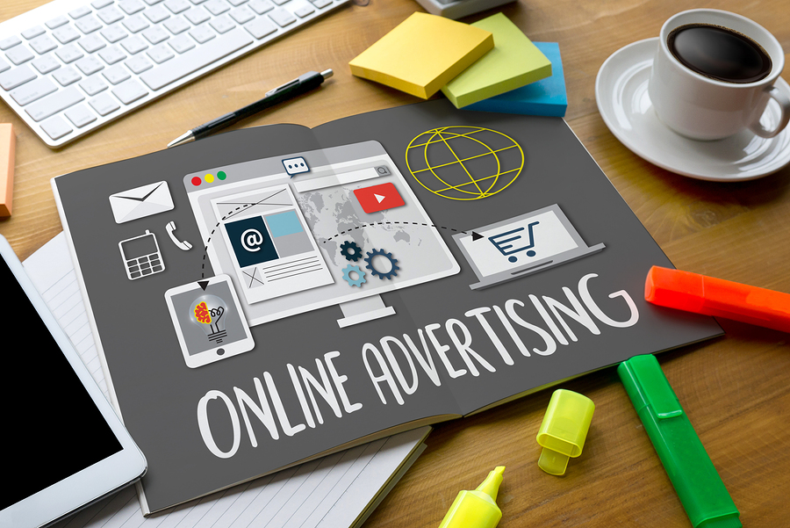
For same investment, Influencer Marketing will cause a greater impact than compared to other levers
Ranking of marketing levers based on volume uplift
1
Italy
2
3
Influencer Marketing
Instore Demos
Paid Media Display/Videos
VOLUME LIFT at same investment
0.71 %
0.64 %
0.40 %
*The levers like Event sampling, proximity sampling, owned media & Paid Media (IG & FB) came out to be inconclusive
*Volume uplift has been calculated using the baseline volume of 4533 units
*Results are based on immediate lift achieved
*Italy has been analyzed for total category and only limited KIND sales are captured in Neilsen database

Slide 9
X-country – volume uplift overview / lever*
Paid Media
Instagram
Paid Media Display/Videos
Owned Media - Instagram
Influencer
Marketing
Instore Demos
Event Sampling
FR
8.4 %
-
3.5%
n/r
1.9%
0.4%
RU
n/r
-
16 %
n/r
4.4 %
1.7 %
IT
n/r
0.40 %
n/r
0.71 %
0.64 %
n/r
First indication that paid & owned media leads to higher uplift vs Field Marketing
to be further validated in other 3 test markets
*Uplift needs to be considered on country level, as baseline volume = different / country
Italy covers only 50% of the market in Nielsen
n/r = data not robust: too little time / not granular enough data points

Slide 10
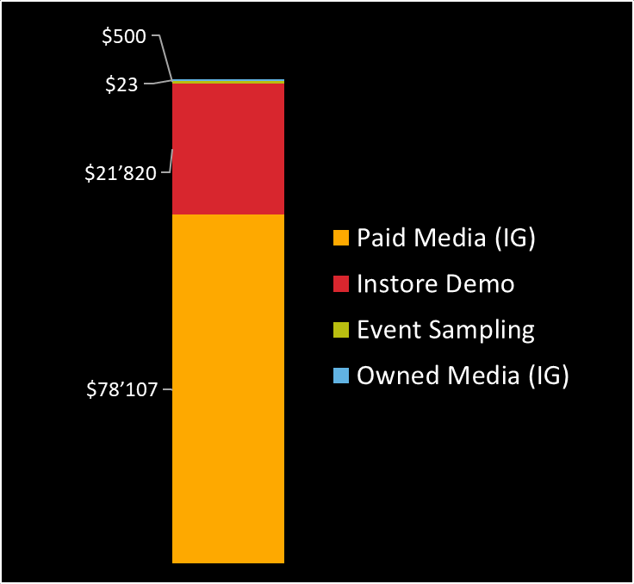
Validation of first learnings by other 3 test markets by mid Apr
UAE, IE, DE
Budget optimization calculater
Investment ratio based on country-specific cost, budget & uplift insights
Min investment thresholds for levers
Brand-awareness building consideration:
How much of the budget should be spent on activities with long-term payback, rather than immediate sales uplift we see in model?
Next steps
~78% budget
~22% budget
Example

